Slide 1
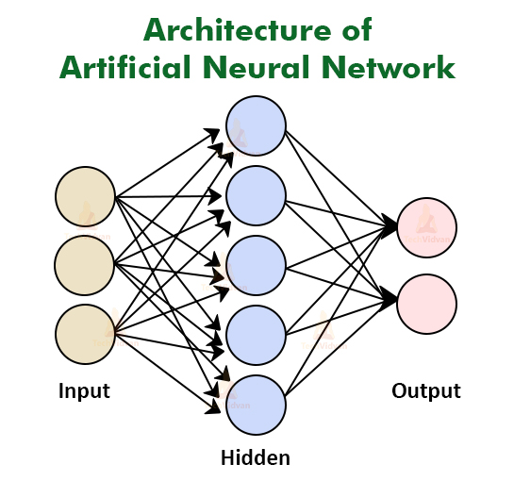
Implementing Feedforward neural networks in Python using Keras and TensorFlow

Slide 2




What are Neural Networks?
Neural networks are a type of machine learning algorithm inspired by the structure and function of the human brain.
They consist of interconnected nodes (neurons) that work collaboratively to process and interpret data.
Key Components
Applications
Neurons
Basic units that receive inputs, apply transformations, and pass outputs.
Image Recognition
Speech Recognition
Layers
Organized collections of neurons, typically including:
Input Layer
Hidden Layers
Output Layer:
Natural Language Processing
Predictive Analysis

Slide 3
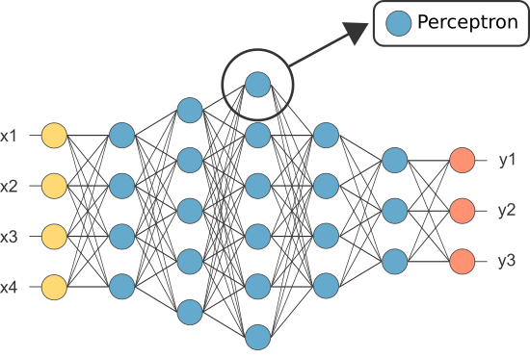
Introduction to Feedforward Neural Networks
Feedforward Neural Networks (FNNs) are a class of neural networks where connections between the nodes do not form cycles.
Information moves in a single direction—from input nodes, through hidden layers, to output nodes.
Characteristics
Non-recurrent: No feedback connections; each layer only connects to the subsequent layer.
Deterministic: Given the same input, the output will always be the same.
Static: Suited for tasks where the input-output relationship does not depend on previous inputs (unlike recurrent networks).

Slide 4
Introduction to Feedforward Neural Networks
1
Data Processing
2
Applications
Neural networks learn from data by adjusting the connections between nodes, effectively creating a model that can make predictions or decisions based on new, unseen data.
Feedforward neural networks have a wide range of applications, including image recognition, natural language processing, and financial modeling.
3
Types
4
Advantages
There are different types of feedforward neural networks, each designed for specific tasks, such as multi-layer perceptrons (MLPs) and convolutional neural networks (CNNs).
They are relatively simple to understand and implement, making them a popular choice for beginners in machine learning.

Slide 5
Architecture of FNNs
Feedforward neural networks have a layered structure. Information flows from the input layer through one or more hidden layers to the output layer. All the layers are fully connected, meaning that every neuron in one layer connects to every neuron in the next layer.
Input Layer
Hidden Layers
Output Layer
Function: The input layer receives data from the outside world. Each node in this layer corresponds to a specific feature or attribute.
Structure: Number of neurons equals the number of input variables (e.g., 784 neurons for 28x28 pixel images).
Function: These layers perform computations and extract patterns from the data.
Structure: The number of hidden layers and the number of nodes in each layer depend on the complexity of the problem.
Activation functions: Introduce non-linearity.
Function: The output layer produces the network's predictions or decisions.
Structure: The number of nodes in the output layer corresponds to the number of outputs or categories.

Slide 6
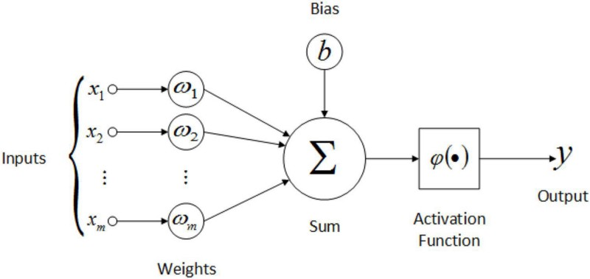
Working of FNNs
The learning process in a feedforward neural network involves adjusting the weights and biases of the connections between nodes.
Forward Propagation:
Input Reception: Data is fed into the input layer.
Weighted Sum: Each neuron computes a weighted
Activation: The weighted sum is passed through an
Propagation: The activated output serves as input
Output Generation: The final layer produces the
1
2
3
4
5
sum of its inputs plus a bias term.
activation function to introduce non-linearity.
for the next layer.
network's prediction.
Loss Calculation:
Measures the difference between the network's prediction and the actual target. Common Loss Functions are: MSE, MAE, Cross-Entropy, etc.

Slide 7
Working of FNNs
Back Propagation:
Minimizes the loss by updating network weights.
Compute Gradients: Calculate the derivative of the loss function with respect to each weight.
Update Weights: Adjust weights in the opposite direction of the gradient using an optimization algorithm (e.g., Gradient Descent).
Training process:
Epochs: Number of complete passes through the training dataset.
Batch Size: Number of samples processed before updating weights.
Optimization Algorithms: Techniques like Stochastic Gradient Descent (SGD), Adam, RMSProp
Evaluation:
Metrics for Classification: Accuracy, Precision, Recall, F1-score
Metrics for Regression: R-squared, Mean Absolute Error (MAE), Root Mean Squared Error (RMSE)

Slide 8
Use cases
Wine Quality Prediction:
Feedforward Neural Networks (FNNs) can be used to predict the quality of red wine based on features such as acidity, sugar content, and pH level. By training an FNN on the Wine Quality dataset, the model learns complex relationships between these chemical properties and the wine's quality rating, allowing it to predict future ratings for unseen data.
Handwritten Digit Recognition (MNIST):
FNNs are also effective for recognizing handwritten digits from the MNIST dataset. By feeding pixel values of 28x28 images into the network, the FNN processes the image data through hidden layers, enabling the model to classify digits (0-9) with high accuracy. This application showcases FNNs' power in image classification tasks.

Slide 9

Overview of Keras and TensorFlow
Keras and TensorFlow are popular Python libraries for building and training machine learning models, including feedforward neural networks.
Keras
TensorFlow
High-level API for building neural networks
Low-level library for numerical computation and machine learning
Easy to use and intuitive syntax
Powerful and flexible framework with extensive features

Slide 10





Real Life Applications
Feedforward neural networks are widely used in various real-life applications, making a significant impact on various industries.
Image Recognition
Speech Recognition
They are used for tasks such as object detection, image classification, and facial recognition, making them crucial for self-driving cars, security systems, and photo tagging apps.
Feedforward neural networks power voice assistants, speech-to-text software, and other applications that rely on understanding spoken language.
Medical Diagnosis
Financial Forecasting
They assist in diagnosing diseases by analyzing medical images, patient data, and genetic information, contributing to early detection and personalized treatment plans.
They are used to predict stock prices, analyze market trends, and assess financial risk, enabling informed investment decisions.

Slide 11
Conclusion
In conclusion, Feedforward Neural Networks (FNNs) are a fundamental building block of deep learning, offering a straightforward yet powerful architecture for various machine learning tasks. By processing information in a unidirectional flow from input to output through multiple layers, FNNs can model complex patterns and relationships in data. Despite their limitations, such as the potential for overfitting and computational intensity, their adaptability and effectiveness across fields like image recognition, natural language processing, and predictive analytics demonstrate their crucial role in advancing artificial intelligence.

Slide 12
Thank You!

